Slide 1
Corvit Systems Multan
Report
Muhammad Adnan
Supervisor: Muhammad Bilal

Slide 2
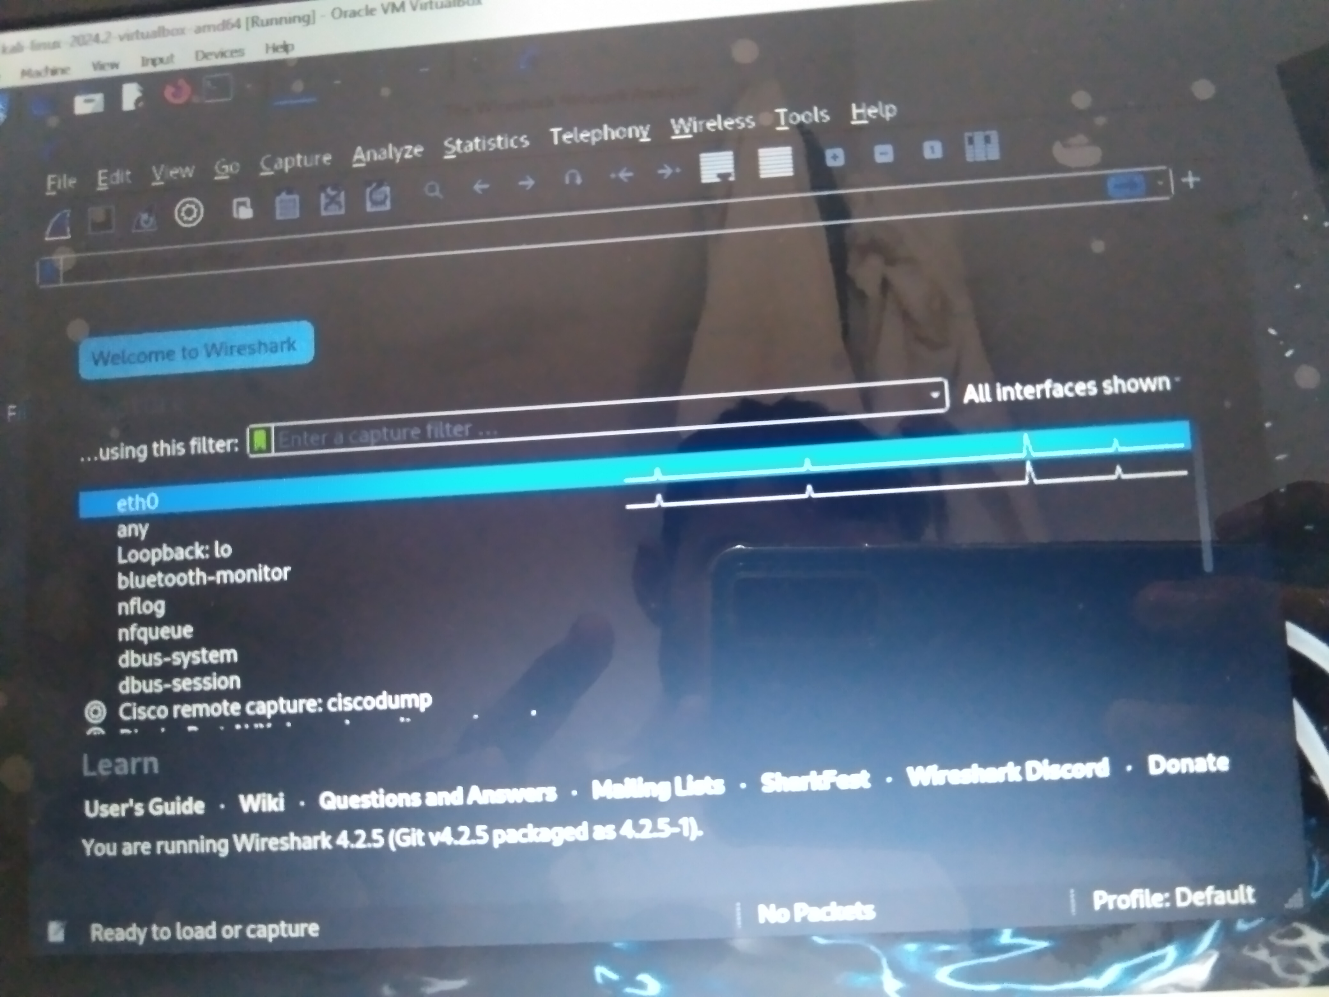
Wireshark

Slide 3
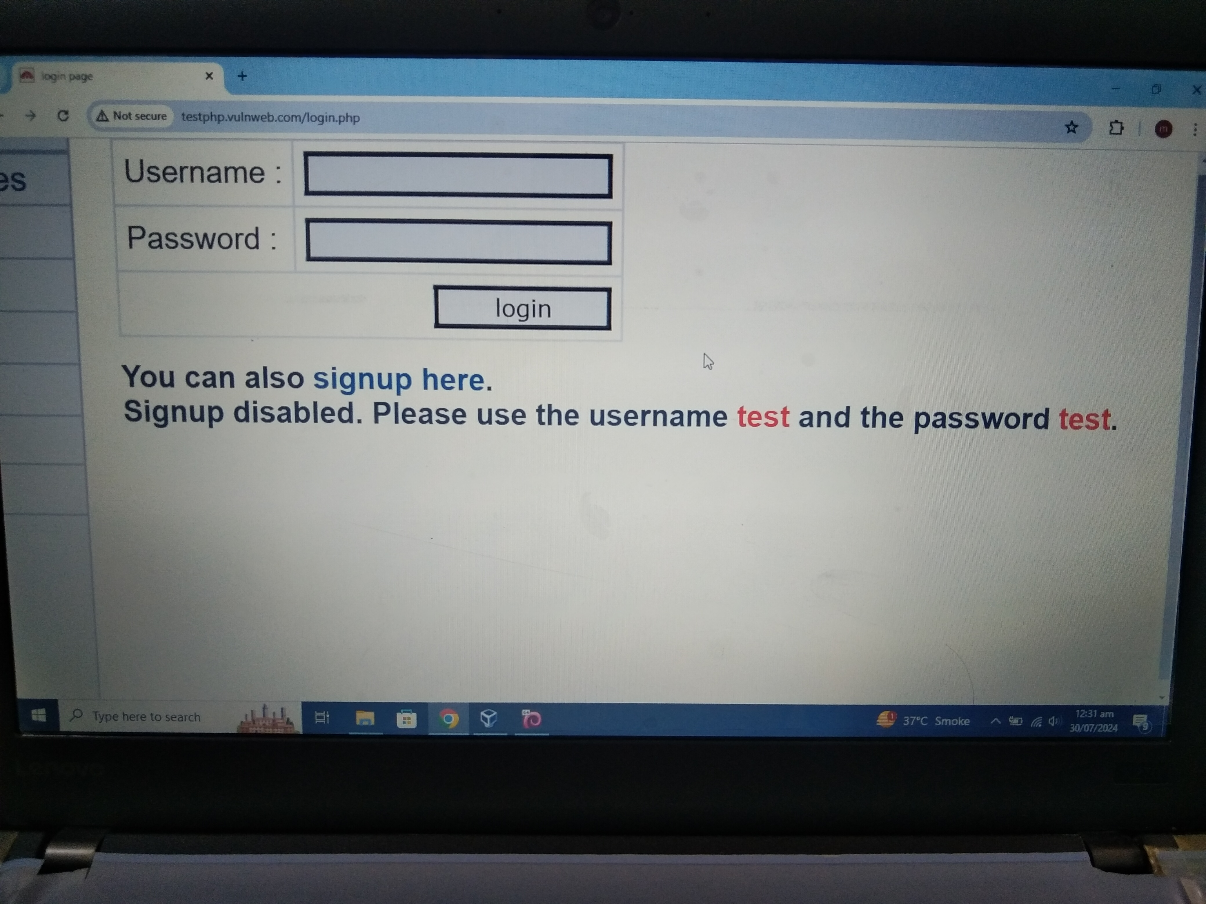

Slide 4
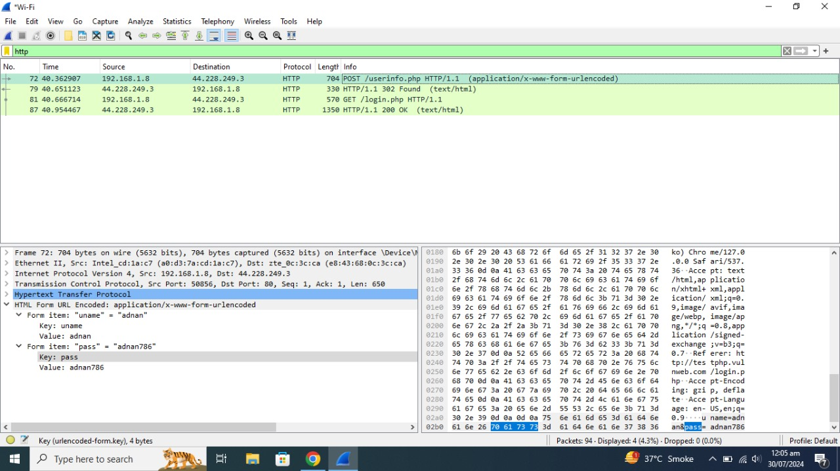

Slide 5
WHEN I PING THE GOOGLE.COM IT SHOW THE PRIVATE IP BUT WHEN I PING IN THE NCBAE.EDU.PK WEBSIITE IT ALSO GIVE THE PRIVATE IP, WHY?
Reason

Slide 6
“The most likely reason you're getting a private IP address when pinging ncbae.edu.pk is that the DNS server you're using is configured to resolve that domain to an internal IP address for network management or access control purposes.”
"configured" means that the DNS server has been set up or adjusted to return a specific IP address for the domain ncbae.edu.pk, which in this case is a private IP address rather than a public one. This configuration could be done for reasons such as network routing, security, or internal resource access.

